Slide 1
Gemstone Price Prediction
MIS-5560
Group 5
Aishwarya Sangal Deepa Palariya Savannah Schwenk Vasudha Gulati

Slide 2
Agenda
Introduction & Hypothesis
Data Overview
Numeric Variable Analysis
Categorical Variable Analysis
Building Models
Summarizing Results
Conclusion
Shortcomings
Key Takeaways

Slide 3
Introduction/Hypothesis
Our goal is to evaluate the predictive performance of the price variable of 27000 cubic zirconia gemstones so it can distinguish between higher profitable stones and lower profitable stones so as to have a better profit share using different modeling techniques.
Scenario 1: Multiple Linear Regression
Scenario 2: Classification and Regression Tree (CART)
Scenario 3: Neural Network
Compare all the models and pick best model for predicting price of Gemstones.
Provide the 3 most important variables from the best pick model.

Slide 4
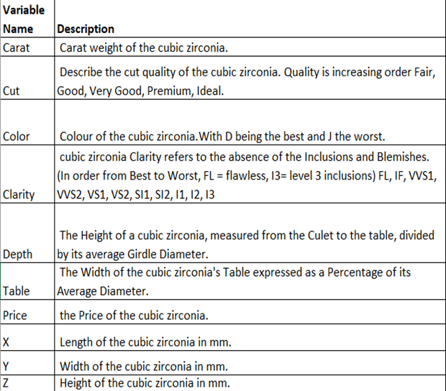
Data Overview
Data Source: https://www.kaggle.com/datasets/colearninglounge/gemstone-price-prediction?select=cubic_zirconia.csv
Rows ~ 27000
Columns - 10
Data Split -
Training - 70%
Validation - 30%

Slide 5
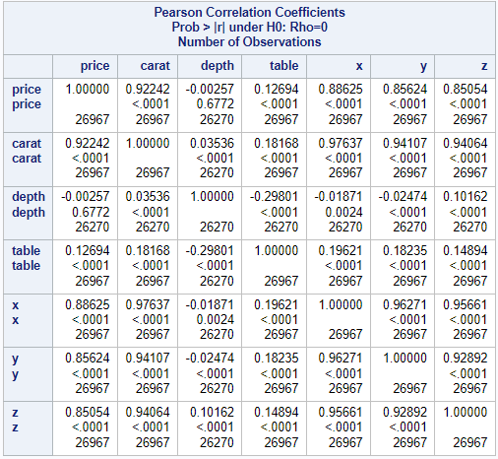
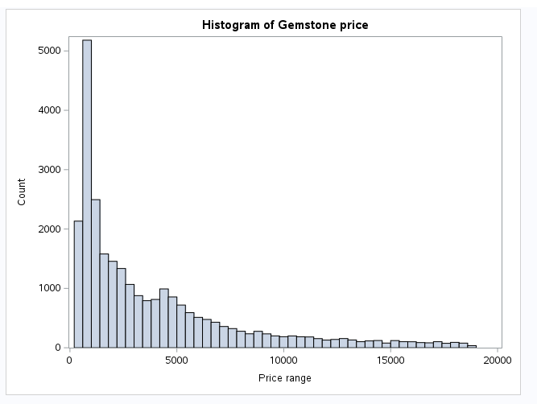
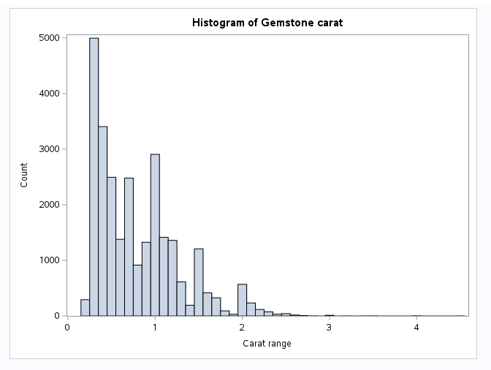
Numeric Variable Analysis
Correlation matrix indicates that the price is highly correlated with Carat, Table, x, y and z variables.
Histogram of carat and price showing distribution of different values.
Notes:
LWH; Wide and moderate distribution. Both right skewed; 100-200 central tendency, no outliers; 0.25-0.35 central tendency

Slide 6
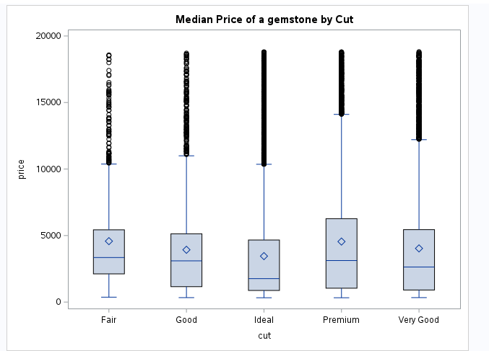
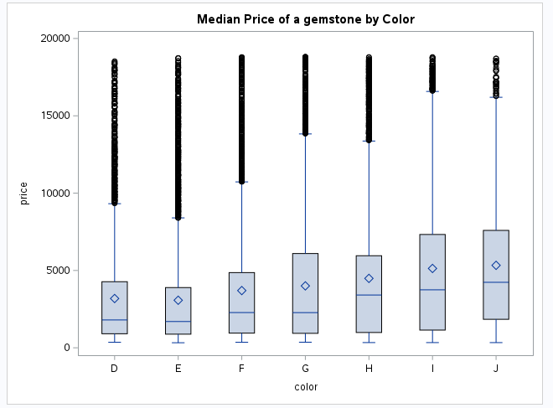
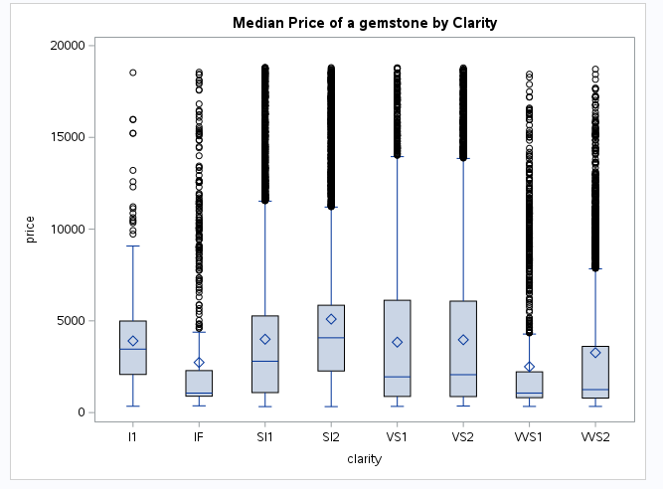
Categorical Variable Analysis
Boxplots for cut, color and clarity shows the outliers and median for their different levels.
Notes:
Color- max outliers for E and min for I,
Right skewed for all. All values are mean above median. I&J max price. Premium Max price & VS1 & VS2 max in range and mean and median

Slide 7
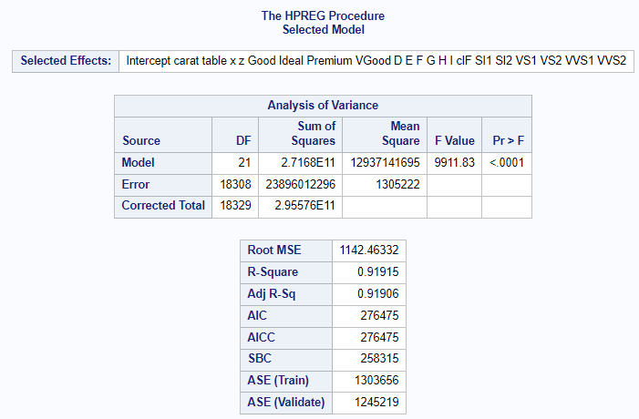
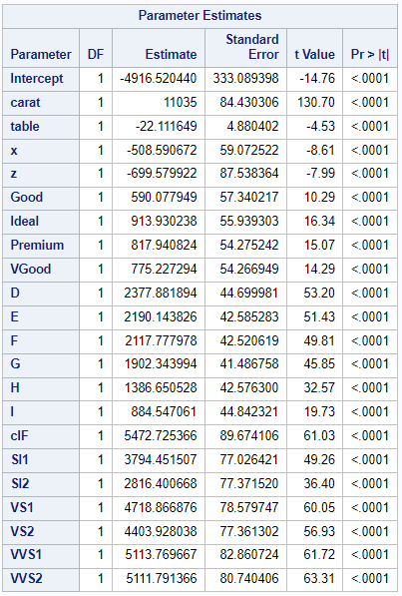
Multiple Linear Regression
Model is statistically significant.
Adj R2 is 92%
ASE (Validate) < ASE (Train) - no over-fitting.
Model performed well.
Notes:
fair,J & fl is base

Slide 8
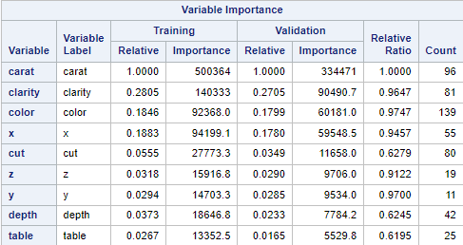
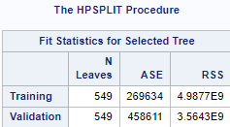
CART
The CART model was built using RSS since our outcome was numeric.
ASE(Valid) > ASE(Train) - indicates overfitting.
Top three important variables - Carat, Clarity and Color
Overall, the model did not perform well.

Slide 9
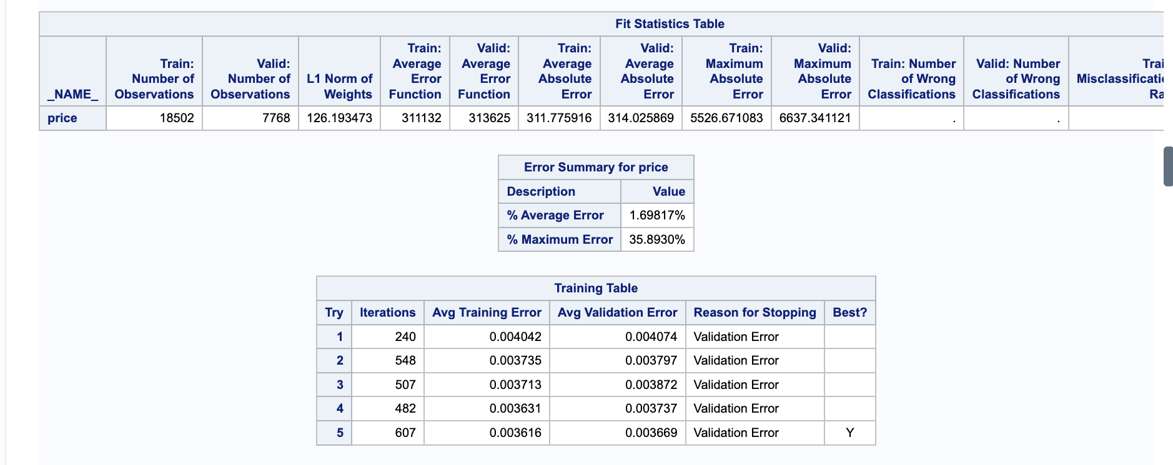
Neural Network
After trying 4 different NN models, the model with 20 hidden nodes performed the best.
The AAE(Train) and AAE(Valid) went down.
AAE(Valid) is slightly higher than AAE(Train).

Slide 10
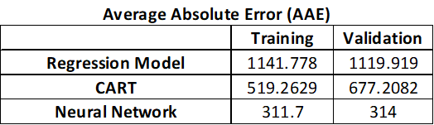
Summarizing Results
Comparing the three models, Neural Network has the least AAE value for training and validation set.
No indication of overfitting in Neural Network.
According to CART model, 3 important variables are - carat, color and clarity.

Slide 11
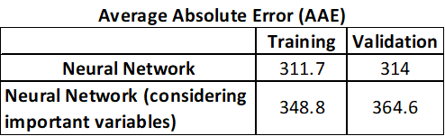
Neural Network (rebuilt)
Variables considered: color, clarity & carat.
Built with 2 layers:
Layer 1 : 3 neurons
Layer 2: 10 neurons
Best model

Slide 12
Conclusion
In addition to Price and Carat being highly correlated, Carat is identified as one of the important variable to predict price.
The gemstones with SI2 and SI1 clarity are more profitable.
The popularity of colored gemstones have increased for their right price and uniqueness which is justified by our analysis - color J is more profitable.

Slide 13
Shortcomings
Limited dependent variables in the dataset.
The data is 2 years old and gemstone prices are heavily influenced by marketing conditions. Data should be continuously updated for more accurate and relevant prediction.

Slide 14
Key Takeaways
Different modeling technique helps exploring their weakness and strengths.
Feature engineering: With combination of models built and domain knowledge, we came up with important features to consider.
Parsimonious model was chosen over the best fit model.

Slide 15
References
Kaggle, “Gemstone Price Prediction”, https://www.kaggle.com/datasets/colearninglounge/gemstone-price-prediction?select=cubic_zirconia.csv.
The 4 C’s of “Gemstones Prediction”, https://www.ganoksin.com/article/4-cs-gemstone-valuation/
Gemstone market, https://www.futuremarketinsights.com/reports/gemstones-market

